Slide 1

PYTHON
Yash Sharma
Ishant Malik

Slide 2
Why Python?
Easy to Use.
Easy to Understand with a straight forward syntax.

Slide 3
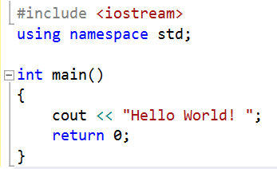

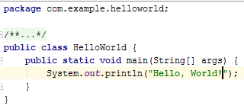
Hello World in C++
Hello World in Python
Hello World in Java

Slide 4
Why Python?
Easy to Use.
Easy to Understand with a straight forward syntax.
Free and open-source
Portability
Large standard libraries to solve common tasks
Interactive
Works like magic
I Love Python.

Slide 5

What can I do with Python?
Anything
Make Games (PyGame)
Build Websites (Django, Flask)
Data Analysis (Numpy, Pandas, SciPy)
Control Robots
Create GUI (PyQT)

Slide 6
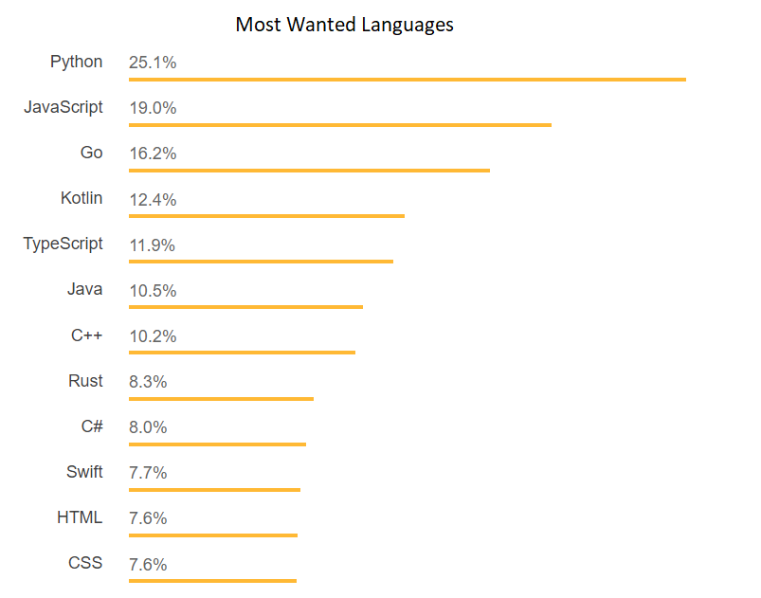
want more?

Slide 7
Convinced?

Slide 8
Installing Python

Slide 9
https://goo.gl/yrynvv

Slide 10
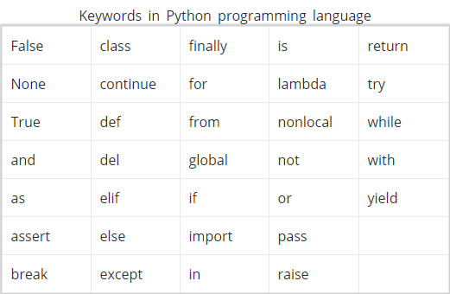
Keywords (or reserved words)

Slide 11
Identifiers
Identifier is the name given to entities like class, functions, variables etc. It helps differentiating one entity from another.
Rules to write Identifiers:
Identifiers can be a combination of letters in lowercase (a to z) or uppercase (A to Z) or digits (0 to 9) or an underscore (_).
An identifier cannot start with a digit.
Keywords cannot be used as identifiers.
We cannot use special symbols like !, @, #, $, % etc. in our identifier.

Slide 12
Functions
A function is a named section of a program that performs a specific task. In other words, a function is a group of related statements that perform a specific task.
Functions help break a program into smaller and modular chunks. As the size of the program grows larger and larger, functions make it more organized and manageable.
Furthermore, it avoids repetition and makes code reusable. (DRY)
Example of a function in Python
def greet (name):
“””
This function greets to the person passed in as parameter
“””
print("Hello, " + name + ". Good morning!")

Slide 13
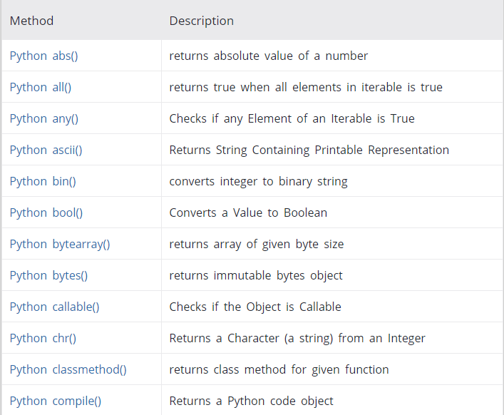
Python Built-in Functions
Complete List Available on:
https://www.programiz.com/python-programming/methods/built-in

Slide 14
Lists
Collection of Arbitrary Objects.
Lists are Mutable
Features of Lists
Lists are ordered.
Lists can contain any arbitrary objects.
List elements can be accessed by index.
Lists can be nested to arbitrary depth.
Lists are mutable.
Lists are dynamic. It can grow and shrink as needed.

Slide 15
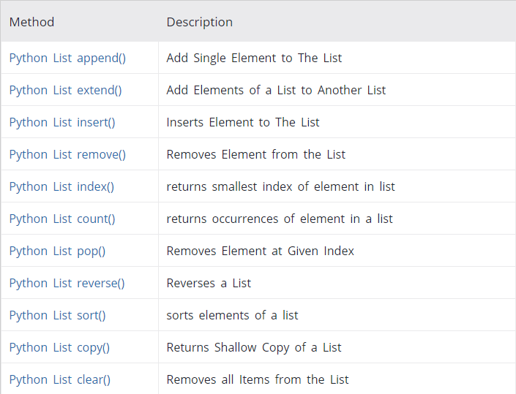
List Manipulation

Slide 16
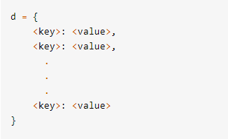
Dictionary
Python’s implementation of an associative array.
A dictionary consists of a collection of key-value pairs.
Features of a Dictionary:
Mutable
Dynamic
Nested
Unordered
Elements are accessed via keys

Slide 17
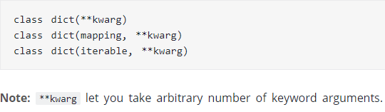
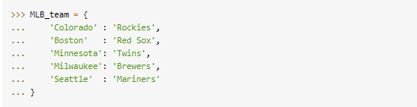
Dictionary
dict() constructors
Example

Slide 18
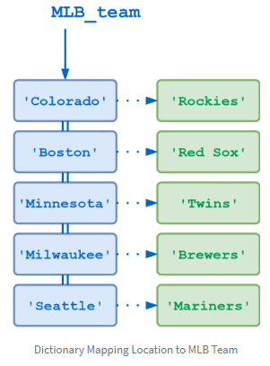
Image Source:
https://files.realpython.com/media/t.b3e3d8f2d100.png

Slide 19
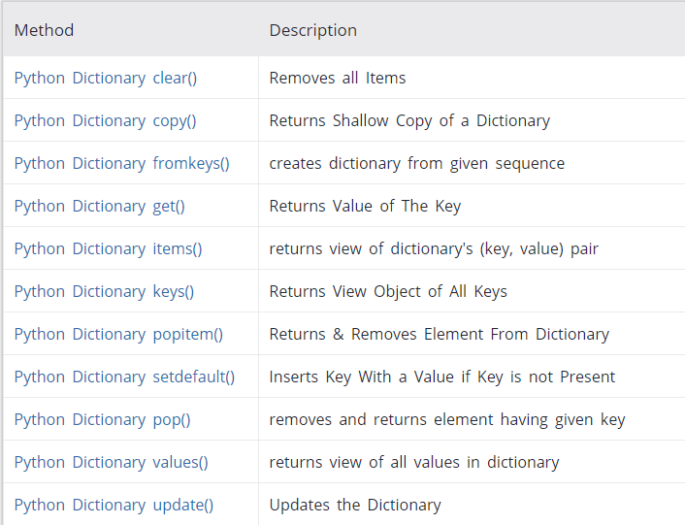
Dictionary Methods

Slide 20
THANK YOU

